Slide 1
Creating HTML5 Content
Notes:
In this chapter we're going to start looking at new features available in HTML5. The journey will take us through to the end of this course! We'll see some interesting CSS3 effects as well during this time.

Slide 2
Contents
Semantic mark-up tags
Additional tags and attributes
Form handling
Annex
Aria
Demos folder:
Demos\05-Html5Content
Notes:
Section 1 introduces you to a new set of tags in HTML5, known as semantic tags. These tags are a bit more meaningful than just using <div> elements everywhere in your Web page!
Section 2 describes a miscellaneous variety of additional new tags and attributes in HTML5, which can make your life a bit easier. In particular, we'll show how you can parachute any attributes you like to an element, via the data-* attribute naming convention.
Section 3 unveils a host of new types of input controls in HTML5, e.g. a standardized date picker, colour picker, etc.
The annex at the end of the chapter describes Aria, an assistive technology to help screen readers understand how to interpret the content of a Web page.

Slide 3
1. Semantic Mark-up Tags
Overview of semantic mark-up tags
Using semantic tags
Going further with semantic tags
Using traditional HTML elements
Viewing the sample document
Notes:
We'll kick off this chapter with a discussion of the new semantic tags in HTML5. The word "semantic" means "meaning". In other words, the semantic tags convey more meaning than using boring old vanilla <div> tags everywhere :-}

Slide 4
Overview of Semantic Mark-up Tags
HTML5 defines semantic mark-up tags
Emphasise the purpose of the mark-up in a page
More meaningful than <div id="header"> etc.
header
nav
article
aside
Element
section
Description
footer
<header>
Header content for a page, or for a section within the page
<footer>
Footer content for a page, or for a section within the page
<section>
A part of a web page, useful for general partitioning
<article>
Independent content for an article, typically enclosed within <section>
<nav>
Navigational assistance, e.g. a hyperlinks panel
<aside>
Additional content, similar to a sidebar in a book
<figure>
Self-contained unit of content, optionally with a caption, that can be moved away from the main flow of the document without affecting meaning
<figcaption>
Optional caption or legend for a <figure>
Notes:
Semantic tags emphasize the purpose of an element more clearly than just using <div> elements alone.

Slide 5
Using Semantic Tags
Here's an HTML document that makes use of the semantic tags to define the overall framework of the document
<!DOCTYPE html>
<html>
<head>
<meta charset="utf-8" />
<title>Hello HTML5</title>
</head>
<body>
<header> Header for document </header>
<div>
<nav> Navigation links </nav>
<section> Main content of this page </section>
<aside> Additional info, similar to a sidebar </aside>
<footer> Footer for this part of the page </footer>
</div>
</body>
</html>
SemanticTags/SemanticTags1.html
Notes:
This example shows how you can structure the overall content of an HTML Web page by using semantic tags.
These tags don't have any inherent appearance, e.g. headers and footers don't have a different font, size, or position. However, you can define appropriate CSS styles to achieve the effects you want.

Slide 6
Going Further with Semantic Tags
It's common to use nested semantic tags in combination
To achieve the desired effect
Very useful when you apply CSS style sheets ☺
<section>
<article>
<header> … </header>
<p>This example shows how to use HTML5 semantic markup tags … </p>
<p>This page looks much better if you link it to the stylesheet!</p>
<footer> … </footer>
</article>
<article>
<header> … </header>
…
<footer> … </footer>
</article>
</section>
SemanticTags/SemanticTags2.html
Notes:
Here we've shown how you can combine semantic tags together. You can mix-and-match these elements in any combination; there are no fixed rules about how you arrange them in a Web page.

Slide 7
Using Traditional HTML Elements
You can mix-and-match semantic tags with traditional HTML elements
SemanticTags3.html
<header>
<h1>Hello HTML5</h1>
<h2>Enjoy the ride!</h2>
<h4>Fancy eh!</h4>
</header>
<article>
<ul>
<li>Canvas (2D and 3D)</li>
<li>Channel messaging</li>
<li>Cross-document messaging</li>
...
</ul>
</article>
<aside>
<h3>By the way...</h3>
<p>You can also use many of the traditional HTML tags, such as h1, h2, h3,
p, div, etc. HTML5 is all about evolution, not revolution.
</p>
</aside>
<nav>
<h3>Links</h3>
<a href="http://www.bbc.co.uk/">Auntie Beeb</a>
<a href="http://www.olsensoft.com">Olsen Software</a>
<a href="http://www.swanseacity.net">Swansea City</a>
</nav>
Notes:
It’s also possible to combine "normal" HTML tags with the semantic tags. For example, <nav> is typically used to group <a> hyperlinks into a common panel on the Web page.

Slide 8
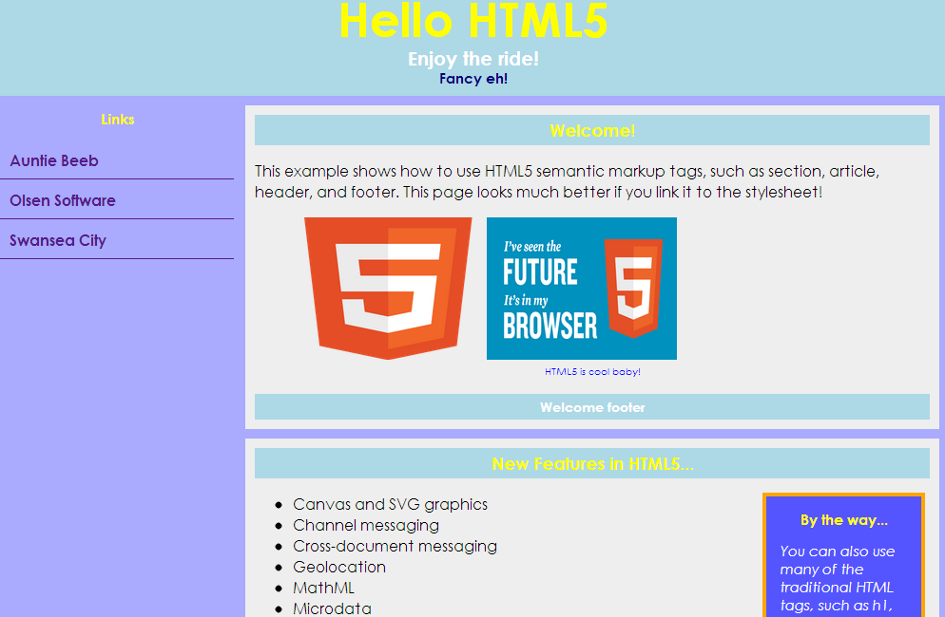
Viewing the Sample Document
Here's the document with a style sheet attached
SemanticTags/MyDocumentWithStyles.html
SemanticTags/MyStylesheet.css
Notes:
This slide shows a complete example of semantic tags, plus an appropriate CSS style sheet to position and style the elements nicely. Take a look at the HTML markup and the CSS rules for a detailed understanding of what's happening here.

Slide 9
2. Additional Tags and Attributes
Defining custom data attributes
Accessing custom data attributes
Example
Miscellaneous additional tags
Example
Notes:
In this section, we're going to investigate various HTML5 tags and attributes that can simplify common Web page development tasks.

Slide 10
Defining Custom Data Attributes
HTML5 allows you to add custom attributes to any element
Prefix with data-
Allows you to augment elements with any additional info that makes sense in your application
E.g. validation rules, semantic business data, etc.
Aside:
Microsoft ASP.NET MVC uses this kind of mechanism to implement client-side input validation
<input id="nameText"
data-format="[A-Za-z]+\s[A-Za-z]+"
data-error-message="You must enter your first name and last name" />
<input id="emailText"
data-format="\w+@[\w.]+([.][A-Za-z]{2,})$"
data-error-message="You must enter a valid e-mail address" />
Notes:
HTML5 allows you to add any attributes you like to an element, as long as you prefix the attribute name with data- (e.g. data-format, etc.).
This is an extremely useful mechanism. It allows you to create intelligent elements that contain all the information they need to describe how to manipulate the element. It's all very "object-oriented" ☺.

Slide 11

Using Custom Data Attributes
You can access custom data attributes in JavaScript code
Via the element's dataset attribute
E.g. if the custom data attribute is named data-my-info
use dataset.myInfo
not dataset.data-my-info
nor dataset.my-info
Example:
// Get an element.
var elem = … ;
// Get its custom data attributes.
var format = elem.dataset.format; // Or elem.dataset["format"]
var errorMsg = elem.dataset.errorMessage; // Or elem.dataset["errorMessage"]
Notes:
If an element has a data-* attribute, you can access the attribute in JavaScript code via the naming convention shown in the slide. Note that hyphens in the attribute name are removed, and the letter after the hyphen is capitalized instead.

Slide 12
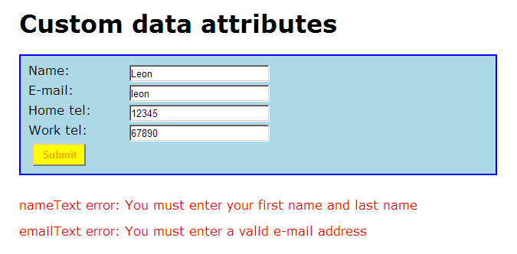
Example
Example of custom data attributes:
See Additional/CustomDataAttributes.html
Note: For non-supporting browsers (e.g. IE11), do this:
var elem = … ;
var format = elem.getAttribute('data-format');
var errorMsg = elem.getAttribute('data-error-message');
Notes:
The example in the slide gives a complete demonstration on how to use custom data attributes. Open the Web page in a browser to see how it works, then look at the HTML and JavaScript code to see how it's implemented.

Slide 13
Miscellaneous Additional Tags
HTML5 defines some additional useful elements…
Element
Description
<hgroup>
Indicates its contents should be displayed as a single heading.
<time>
Displays a time or duration in a standard way. Has a datetime attribute that represents the date/time in an ISO-standard way.
<mark>
Indicates a portion of text should be marked or highlighted, so it stands out.
<small>
Indicates a portion of text should be displayed in small print.
Notes:
HTML5 is a very broad standard. Some of its innovations are important and game-changing, whereas others are relatively minor…
The new elements described in the slide definitely fit into the latter category! The following slide shows an example of how to use these new tags.

Slide 14
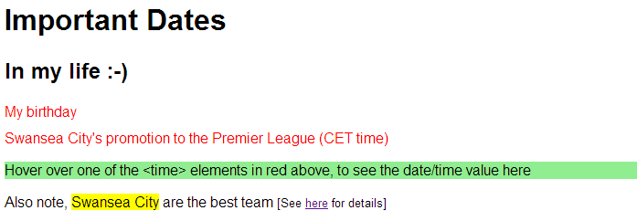
Example
Example of miscellaneous additional tags:
See Additional/MiscellaneousTags.html
Notes:
This slide shows an example of the new tags that we introduced on the previous slide. Take a look at the HTML markup to understand how it works ☺

Slide 15
3. HTML5 Forms
Organising a form
Input control attributes
Input control tags
Notes:
To conclude this chapter, we're going to take a look at various new types of input controls (and attributes thereof) that you can use in HTML5.

Slide 16
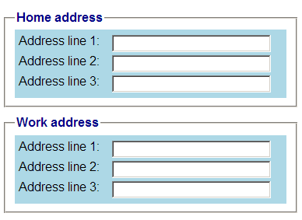
Organising a Form
HTML5 allows you to partition a forms into field sets
Use <fieldset> to group related fields
Add a <legend> child element, if you want to define a heading
Add <div> child elements, if you want to define styles
Example
See Forms/FieldSets.html
<form>
<fieldset>
<legend>Home address</legend>
<div class="formpanel">
… input controls here …
</div>
</fieldset>
<fieldset>
<legend>Work address</legend>
<div class="formpanel">
… input controls here …
</div>
</fieldset>
</form>
Notes:
HTML5 has a <fieldset> element that allows you to group related fields in a form. It looks much like a group-box. You specify the text for the group-box via a <legend> element, and then use <div> elements if you want to define styling for the contents.

Slide 17
Input Control Attributes (1 of 2)
HTML5 supports several new attributes on input controls
autocomplete
autofocus
list
multiple
pattern
placeholder
required, min, max
CSS3 supports pseudo-classes for indicating if an input control is valid or invalid
input:valid
input:invalid
Notes:
HTML5 introduces the new attributes described above, which allow you to fine tune the appearance and behaviour of input controls on the Web page. For more information about these attributes, see:
http://www.w3.org/TR/2011/WD-html5-20110525/common-input-element-attributes.html

Slide 18
Input Control Attributes (2 of 2)
Example (open in IE11 for best effects)
See Forms/InputControlAttributes.html
<input type="text" id="myName" size="30"
autofocus
autocomplete="off"
placeholder="Enter your name"
required="true" />
<input type="text" id="myHouseNumber" size="30"
placeholder="Enter your house number"
required="true" />
<input type="text" id="myPostCode" size="30"
pattern="[a-zA-Z]{1,2}\d{1,2}\s\d[a-zA-Z]{2}"
placeholder="Enter a UK post code" />
<input list="countries" id="myBirthCountry" size="30"
placeholder="Select your country of birth" />
<input list="countries" id="myResidenceCountry" size="30"
placeholder="Select your country of residence" />
<input type="file" id="myPics" multiple />
<datalist id="countries">
<option value="England">
<option value="Scotland">
<option value="Wales">
<option value="N. Ireland">
</datalist>
Notes:
This example illustrates the use of several attributes introduced on the previous slide.
Most of these attributes are intuitive, except perhaps the list attribute. The list attribute allows you to point to an out-of-line <datalist> element, which contains the options you'd like to use to fill up the current input control.

Slide 19
Input Control Tags (1 of 2)
New date/time input controls:
date
time
datetime, datetime-local
month
week
New general-purpose input controls:
number
range
email
tel
color
url
search
Notes:
HTML5 provides a host of new input controls, making it easier for the user to enter particular types of values. For more information about these new input controls, see:
http://www.w3.org/TR/html-markup/input.html

Slide 20
Input Control Tags (2 of 2)
Example (open in Chrome or Opera for best effects)
See Forms/InputControlTags.html
<input type="date" placeholder="Enter a date" … />
<input type="time" placeholder="Enter a time" … />
<input type="datetime" placeholder="Enter a date and time" … />
<input type="month" placeholder="Enter a month" … />
<input type="week" placeholder="Enter a week" … />
<input type="number" min="10000" max="50000" value="25000" step="1000" />
<input type="range" min="1" max="10" value="5" />
<input type="tel" placeholder="Enter a telephone number" />
<input type="email" placeholder="Enter an email address" />
<input type="url" placeholder="Enter a URL" />
<input type="color" value="red" placeholder="Choose a color" />
<input type="search" results="3" autosave="mySearch" placeholder="Enter search string" />
Notes:
This example illustrates the use of the new input controls introduced on the previous slide.
Note that support for these new input controls is a bit uneven at the moment; some browsers are better than others. In the long term, the situation will settle down and all browsers will support these input controls properly.

Slide 21
Summary
Semantic mark-up tags
Additional tags and attributes
Form handling

Slide 22
Annex: Aria
Overview of Aria
Accessible forms
Landmark roles
Live regions
Audible validation

Slide 23
Overview of Aria
Aria = "Accessible Rich Internet Applications"
Enables you to add semantics and metadata to HTML content, to make the UI more accessible
Used in conjunction with assistive technologies such as screen readers, which can detect and announce info verbally
Supported as part of HTML5, so that you can implement the following features:
Accessible forms
Landmark roles
Live regions
Audible validation

Slide 24
Accessible Forms
You can link an input field to an element that describes it
Use the aria-describedby attribute
Screen readers will announce the descriptive text on input focus
You can customize the info announced by a Screen Reader
Use the aria-labelledby attribute
Screen readers will announce the series of items specified
Example:
See AccessibleForms.html
<label for="fromText">From aiport: </label>
<input id="fromText" type="text" size="25" aria-describedby="fromDescriptor" />
<span id="fromDescriptor">The airport you're travelling from</span> <br/>
<label id="rangeLabel" for="rangeText">Travel within</label>
<input id="rangeText" type="text" aria-labelledby="rangeLabel rangeText rangeUnit" />
<span id="rangeUnit">days</span> <br/>

Slide 25
Landmark Roles (1 of 2)
Aria defines a set of specialised "landmark" roles
Identifies common Web page sections in a consistent way
Allows assistive technologies to provide users with features which they can use to identify and navigate to sections of page content
To define a landmark role:
Set the role attribute on the element
The following slide lists all the standard Aria landmark roles

Slide 26
Landmark Roles (2 of 2)
Example:
See LandmarkRoles.html
role
Description
HTML5 equivalent element
"application"
Represents a region of the page representing a unique software unit executing a set of tasks
(use on a <div>)
"banner"
Region containing prime heading for the page
(use on a <header>)
"complementary"
Supporting section of the document, e.g. an aside
<aside>
"contentinfo"
Metadata info such as footnote, copyright info, etc.
(use on a <footer>)
"form"
A region of input controls, to submit data to server
(use on a <form>)
"main"
The main content region in the document
(use on a <div>)
"navigation"
Navigation area, where hyperlinks appear
<nav>
"search"
Search area, where user can enter text for a search
(use on a <form> or <div>)

Slide 27
Live Regions
You can designate an element as a "live" region
Tells the Screen Reader to announce content changes
Set the aria-live attribute on an element as follows:
aria-live="off"
aria-live="polite"
aria-live="assertive"
Additional attributes:
aria-atomic
aria-relevant
Example:
See LiveRegions.html

Slide 28
Audible Validation
You can tell Screen Readers when an error occurs
So that the Screen Reader can announce the error message
To tell the Screen Reader an error has occurred, so that the Screen Reader should announce the error:
Create an element such as a <div>
Set its id and role attributes to "alert"
Add the element to the DOM tree
Example:
See AudibleValidation.html

Slide 29
Any Questions?

